Slide 1


Session // 03 TRAINING NEURAL NETWORKS FACULTY OF SCIENCE AND ENGINEERING +++
Diego Corona Lopez – AI Technical Specialist

Slide 2
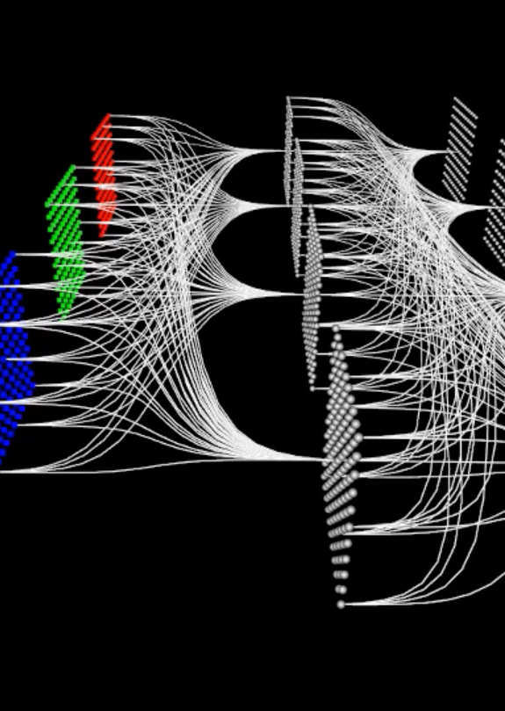
Agenda
Introduction to Convolutional Neural Networks (CNNs)
Understanding what makes CNNs unique for image processing
The Convolution Operation
Mathematical foundations of convolution
Key parameters: kernel size, stride, padding, dilation
Filters in CNNs
Understanding what filters detect in images
Different types of filters for edge detection, sharpening, etc.
Image Data Preparation
Data Loading for Deep Learning
Simple CNN Implementation
Advanced CNN Components
Case Study: Crack Detection in Historical Buildings
Popular CNN Architectures

Slide 3
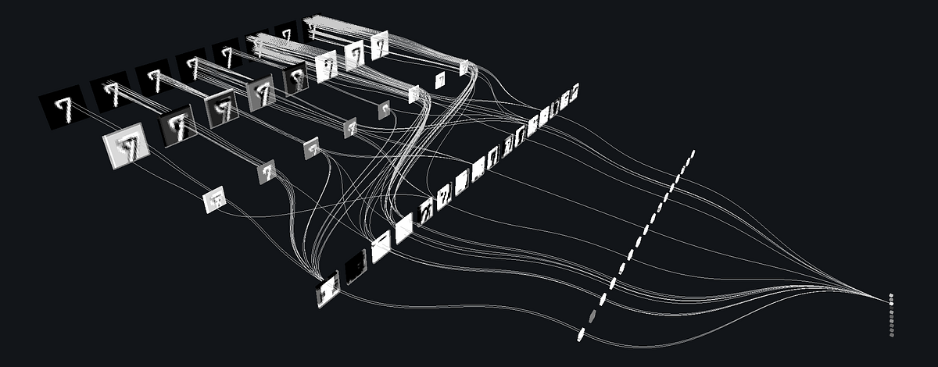
CNN
Convolutional Neural Networks (CNNs) are specialized neural networks designed for processing structured grid-like data, such as images
Inspired by visual cortex organization
Revolutionized computer vision

Slide 4
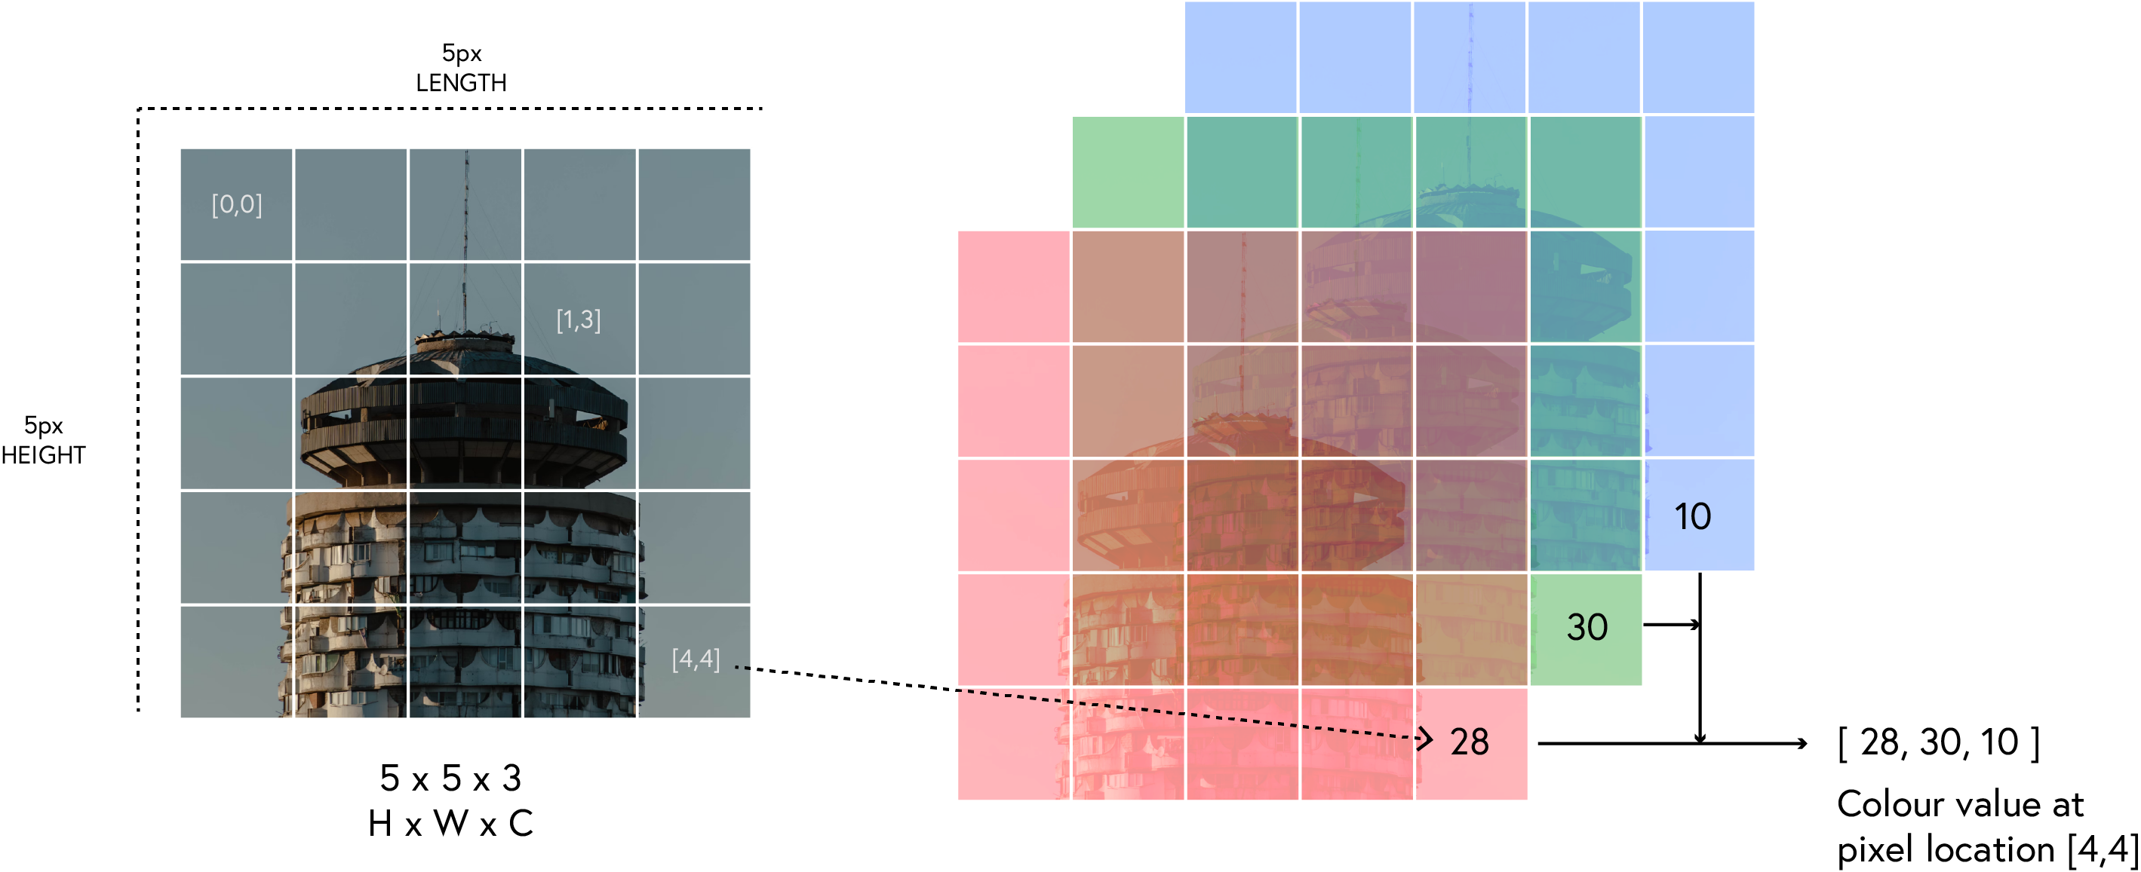
Why Standard Neural Networks Struggle with Images
Spatial Relationships: Standard networks don't account for spatial relationships between pixels
Parameter Explosion: A 224×224×3 image would require over 150,000 weights per neuron
Translation Invariance: Objects can appear anywhere in an image but have the same meaning
Feature Hierarchy: Images contain low-level features that compose into higher-level features
SE04
04

Slide 5
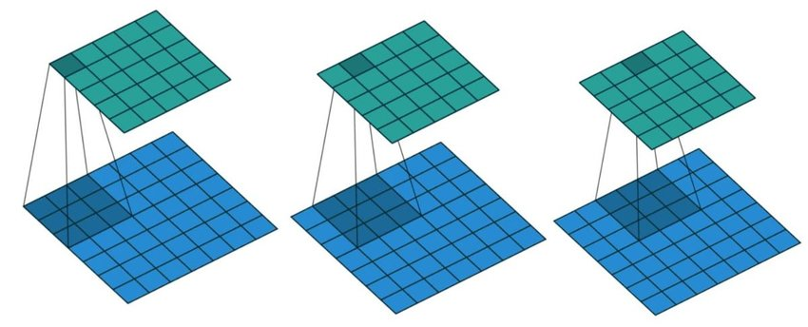
convolution
Definition: A mathematical operation that slides a filter over an input, performing element-wise multiplication and summation

Slide 6
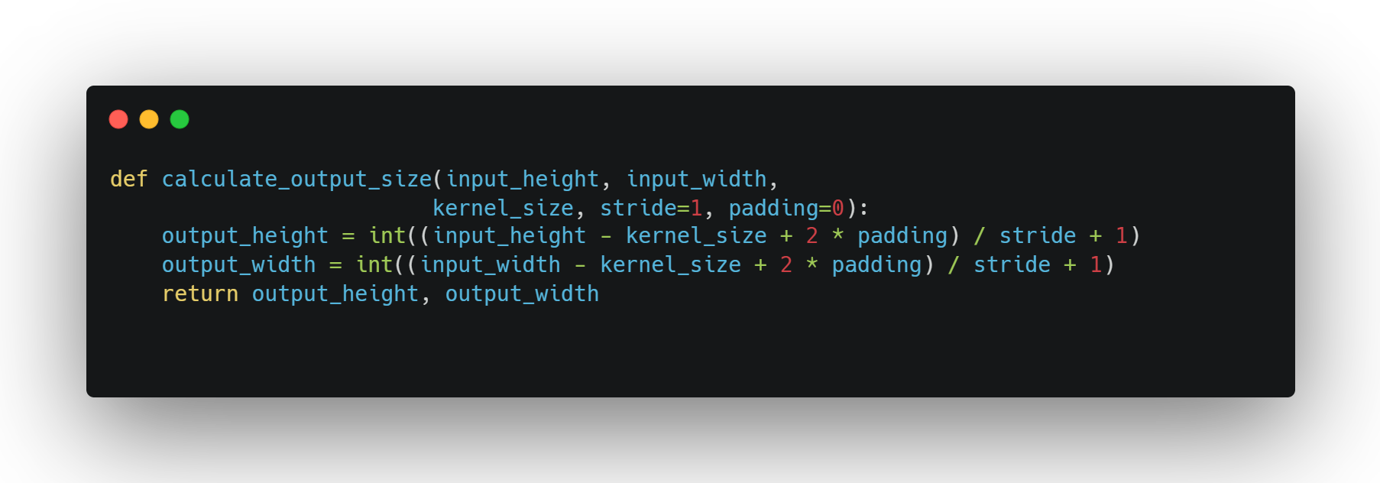
Key Parameters in Convolution
Kernel Size: The dimensions of the filter
Stride: How many pixels the filter shifts
Padding: Adding extra pixels around the border
Dilation: Spacing between kernel elements
SE04
06

Slide 7
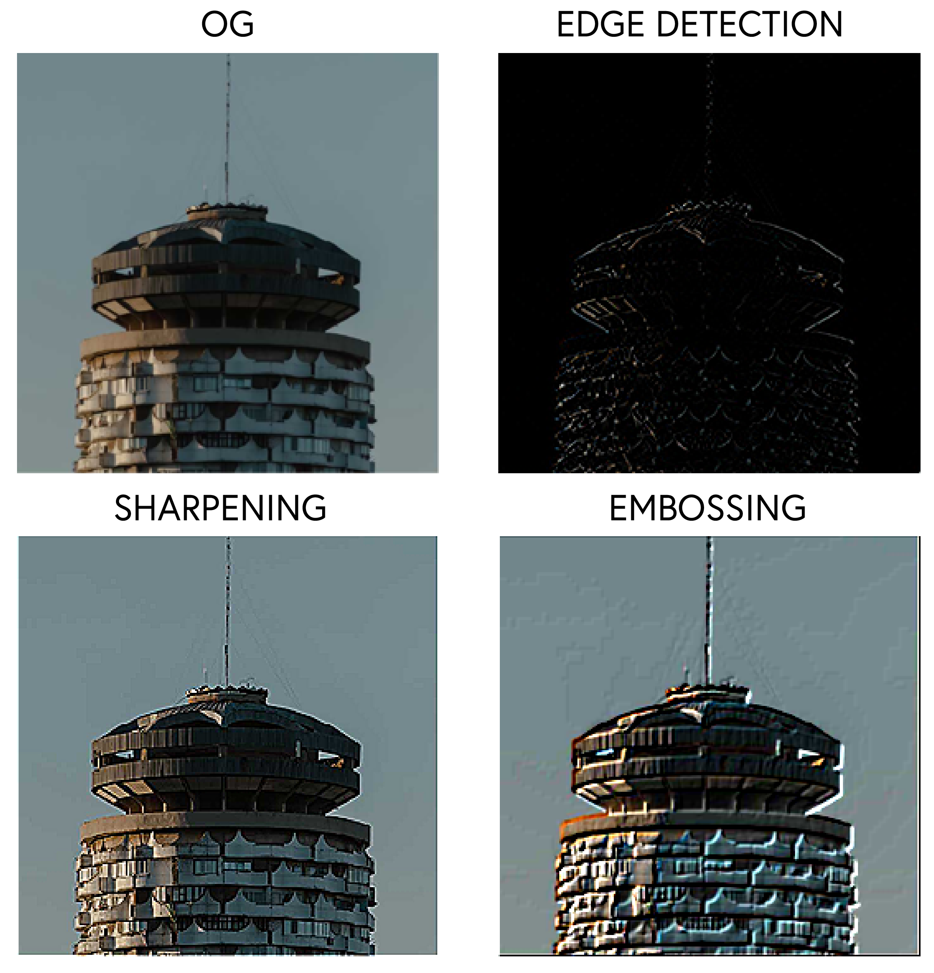
FILTERS IN CNNS
Filters are small matrices that detect specific patterns in images
Different filters detect different features (edges, textures, etc.)
Weights in filters are learned during training
SE04
07

Slide 8
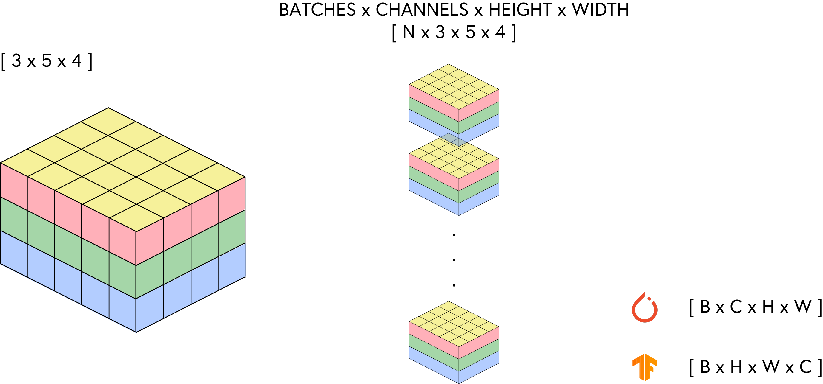
Preparing images
Need to convert images into proper format for CNNs
PyTorch expects 4D tensors: (batch_size, channels, height, width)
Data augmentation techniques increase training set diversity
SE04
08

Slide 9
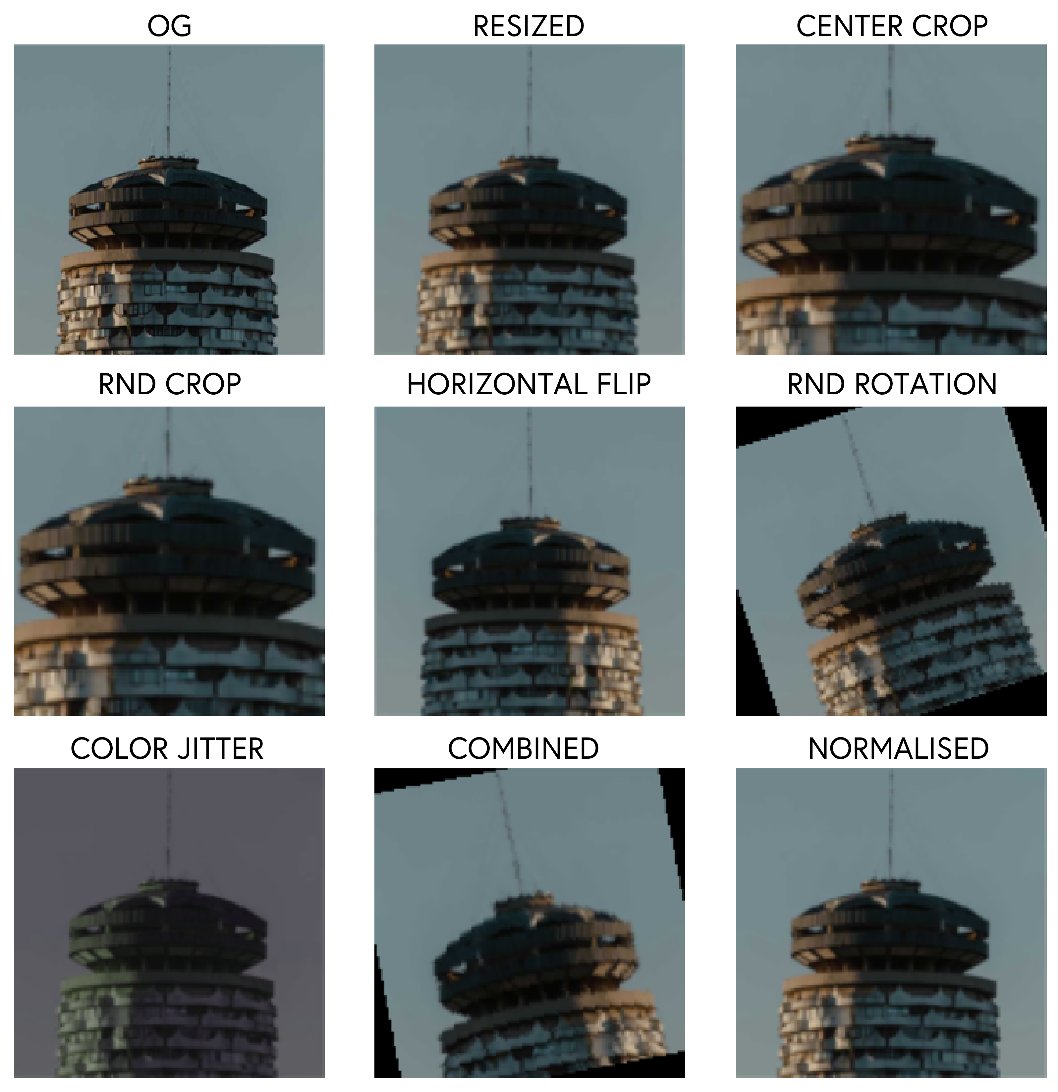
Image Transformations and Augmentation
Artificially expanding dataset by applying transformations
Benefits:
Prevents overfitting
Improves model generalization
Handles varied real-world conditions
Addresses class imbalance
SE03
09

Slide 10
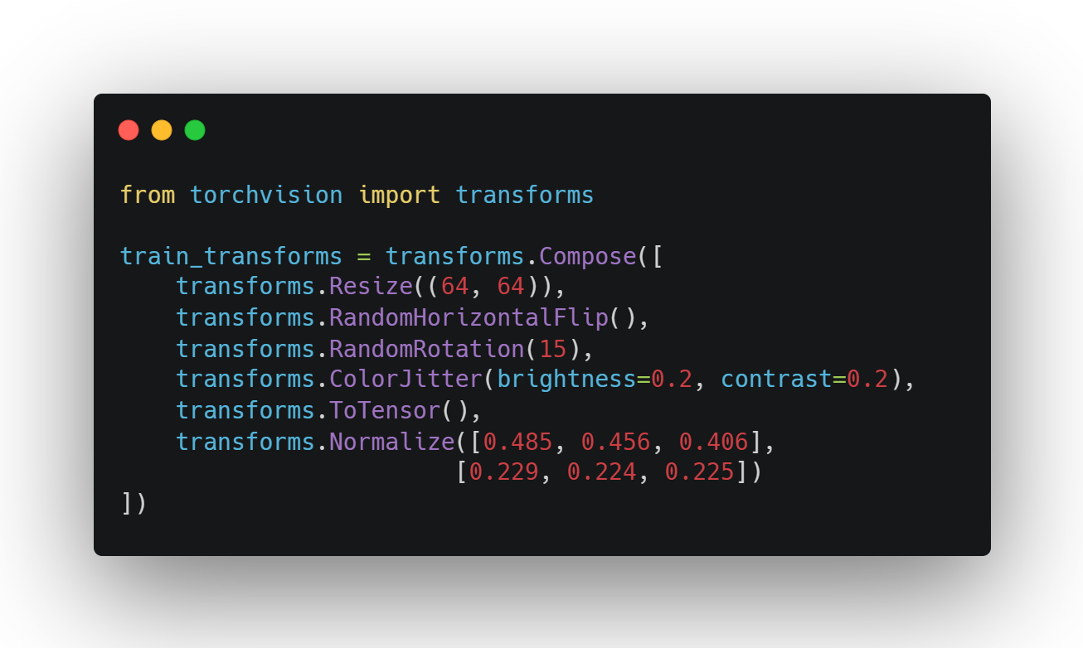
Augmentation techniques
Geometric: Flips, rotations, scaling, cropping
Color: Brightness, contrast, saturation adjustments
Noise: Adding random noise for robustness
Occlusion: Random erasing to simulate partial obscuring
Combining multiple augmentations:
Domain-specific augmentations (e.g., for medical images)
Online vs. offline augmentation
SE03
10

Slide 11
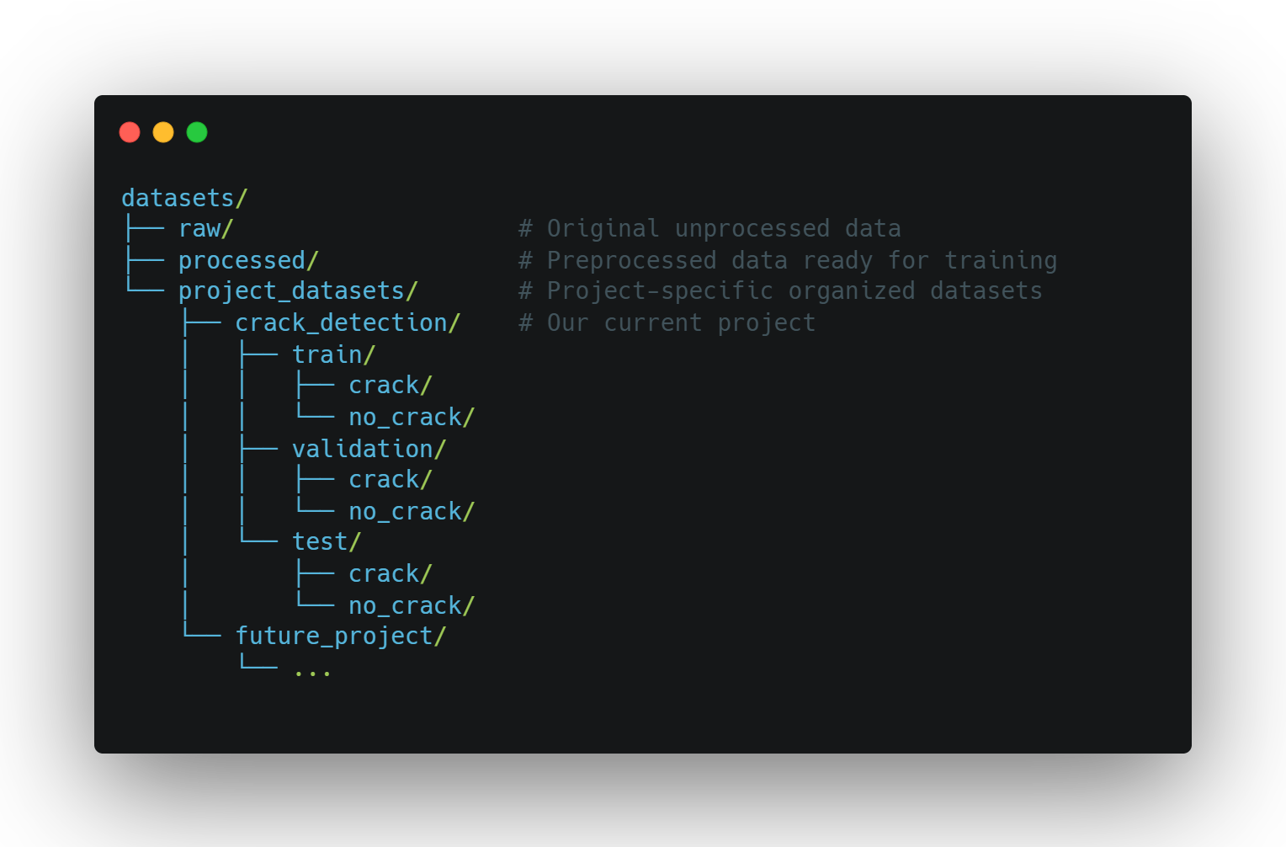
DATASET ORGANISATION
For CNN projects, proper dataset organization is crucial. A well-structured dataset allows for:
Data Splitting Strategies
Train/Validation/Test Split
Stratified Splitting: Ensures class distribution is maintained across splits
Cross-Validation: For smaller datasets or when maximum data usage is needed
SE03
11

Slide 12
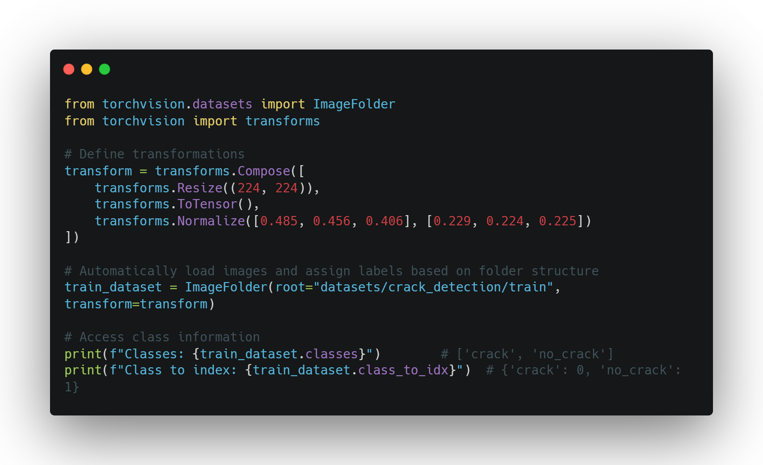
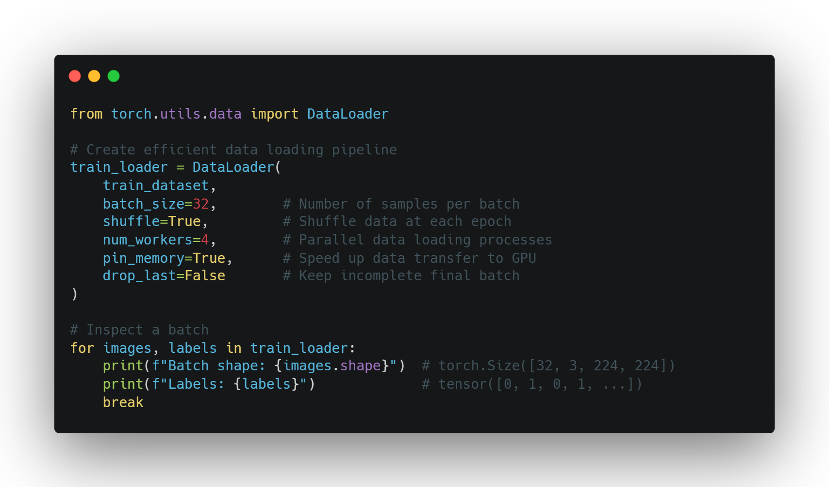
ImageFolder: Smart Dataset Management
Efficient Batch Processing
SE03
12

Slide 13

The Historical Crack Dataset: Preserving Our Heritage
Dataset Overview
757 crack images / 3,139 non-crack images
First dataset specifically for historical building monitoring
Captures unique patterns in traditional materials
Why It Matters
Manual inspection is time-consuming, costly, and error-prone
Historical buildings require specialized monitoring approaches
Early crack detection can prevent catastrophic structural failure
AI solutions can scale inspection across multiple heritage sites
Technical Applications
Automated drone surveys for continuous monitoring
Mobile applications for conservation specialists
Detection of early-stage deterioration before visible to human eye
SE03
13

Slide 14
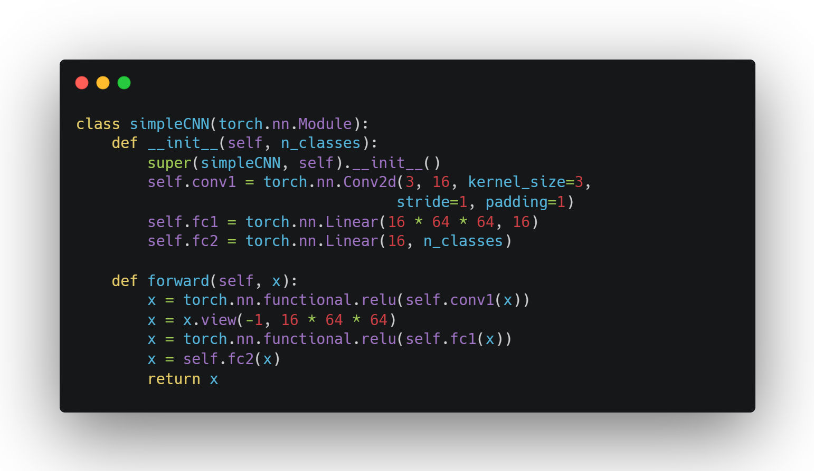
SIMPLE CNN
CNN Components:
Conv2D
ReLU
Fully connected layers
Information flow through the network
Parameter sharing and local connectivity
SE03
14

Slide 15
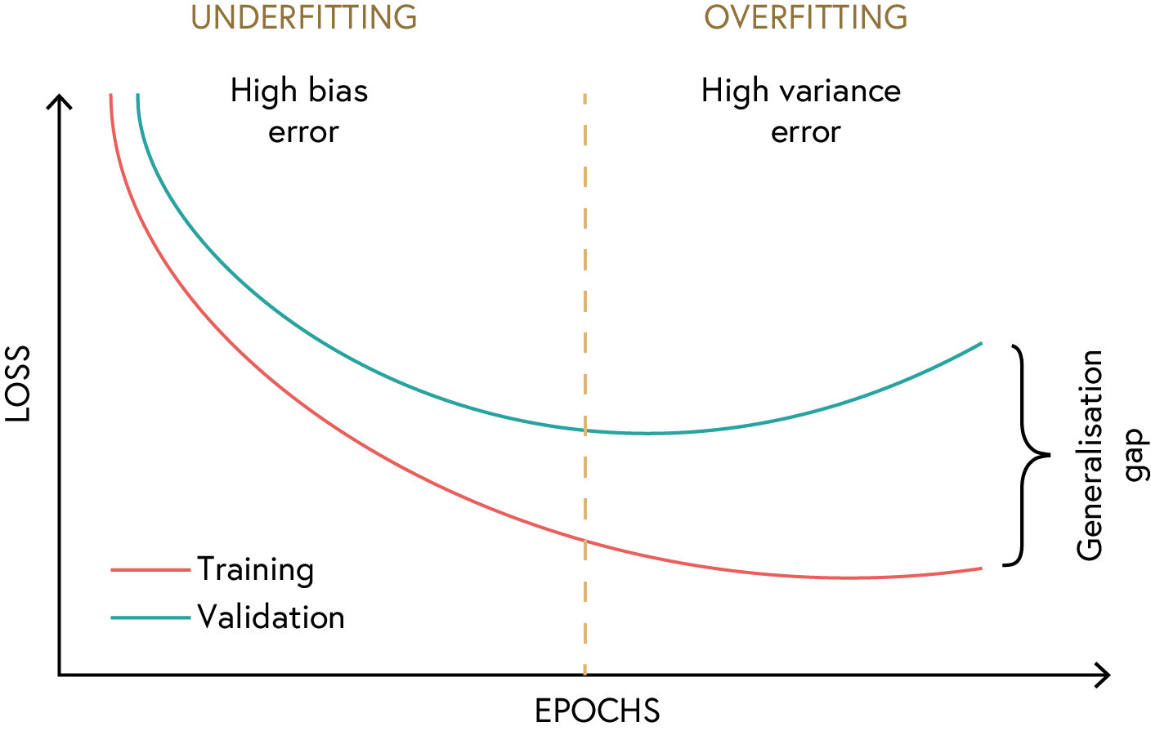
OVERFITTING AND UNDERFITTING
Underfitting: Model too simple, high bias
Overfitting: Model too complex, high variance
Finding the right balance
SE03
15

Slide 16
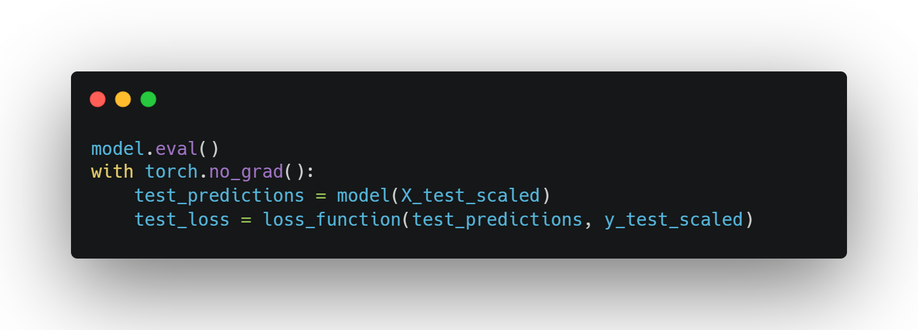
MODEL EVALUATION
Testing on unseen data
Metrics for regression:
Mean Squared Error
R-squared score
SE03
16

Slide 17
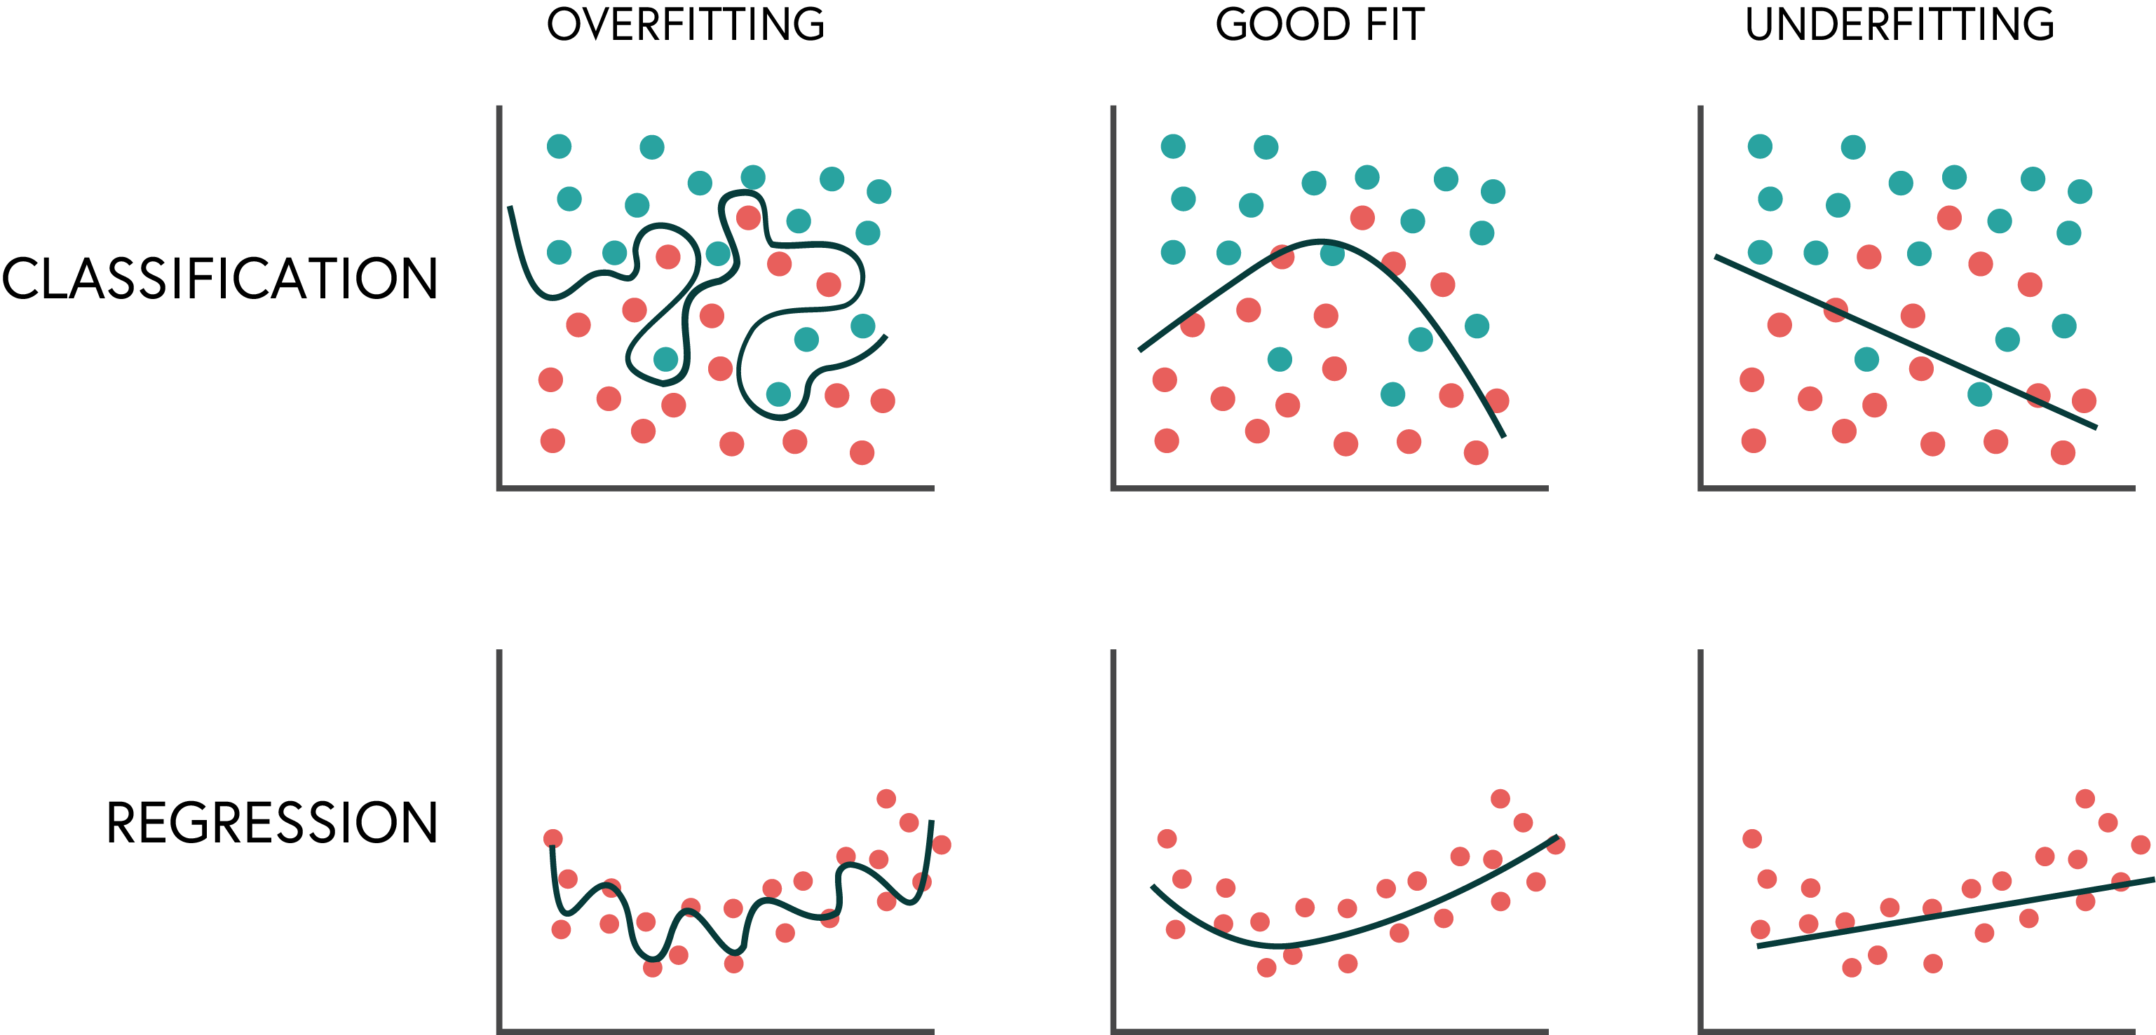
MODEL EVALUATION
SE03
17

Slide 18
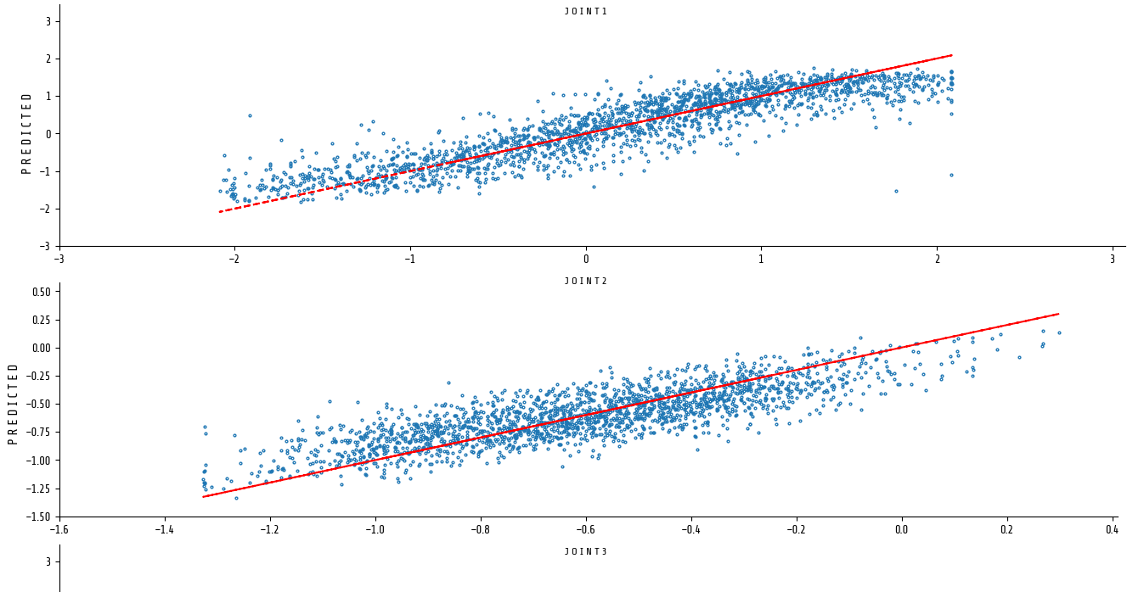
Improving the model
Hyperparameter tuning
Deeper/wider networks
Regularisation techniques
Advanced architectures

Slide 19
Improving the model
Hyperparameter tuning
Deeper/wider networks
Regularisation techniques
Advanced architectures

